Slide 1
NMEA2K boat monitor with Arduino DUE
5 V
GND
2,7K
220
A
VSS
VO
RW
K
VDD
1602A Display
DS18B20
DS18B20
DS18B20
DS18B20
RS
E
D4
D7
D5
D6
4,7K
4,7K
4,7K
4,7K
5
2
4
12
11
3
12
11
46
Arduino DUE
48
50
52
12 V
12 V
SCL 21
8
SDA 20
CANRX
GND
GND
Reset
3,3V
CANTX
Power on reset
(if needed)
2
1 2
MCP2562
CANH
DHT11
10 K
BMP180
1 2 3 4
CANL
100uF
5,6 K
1 3
3 4
8 7 6 5
3,3V
100nF
Cabin tmp & humidity
Engine Comp tmp & Air Pressure
5 V
GND

Slide 2
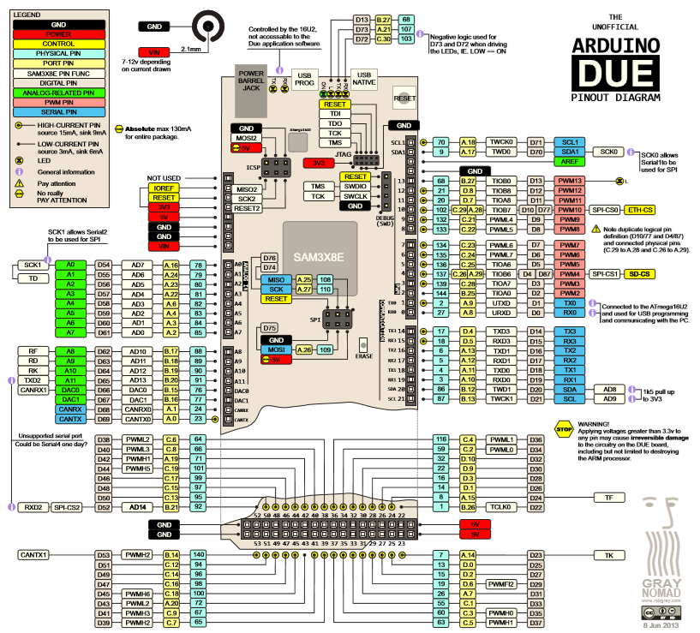
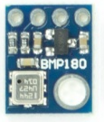
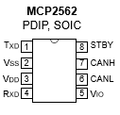
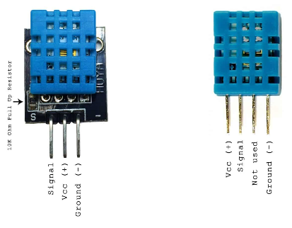
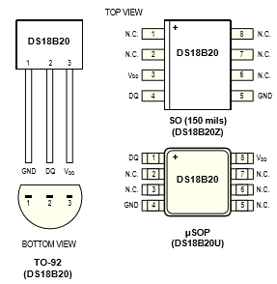
Components
1 2 3 4

